Slide 1
Aws trusted advisor
ow

Slide 2
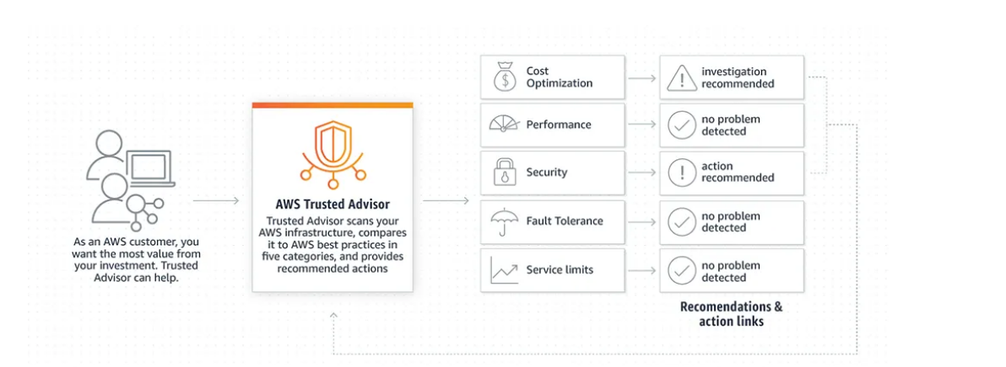
definition
AWS Trusted Advisor provides recommendations to follow best practices by checking your account. It helps to optimize your AWS account by checking the Fault Tolerance,improve performance and security, reduce cost and monitoring service quotas.

Slide 3
recommendation
Cost Optimiztion — It helps you to reduce the cost by analyse the usage and spended money for services. Ex: un-used resources,idle DB instances,under-utilized EBS volumes, excessive timeout in lambda functions.
Performance — It helps to improve the performance of services by analysing the usage and configurations. Ex: EBS throughput and latency, configurations on cloudfront,
Security — It helps to secure your AWS environment. Ex: securiy group risks, exposed access keys,unnecessary S3 bucket permissions.

Slide 4
..
Fault Tolerance — improve the reliablity of your AWS services.Ex: auto scaling, disabled availablity zones, deleted health checks on route 53,disabled RDS backups.
Service Quota — used to create more resources in your AWS account. Trusted Advisor will guide you when you reach more than 80% of quota.
Recommendations are grouped into 3 categories. They are “Green” means no problem detected, “Orange” means investigation recommended, “Red” means Action recommended.

Slide 5
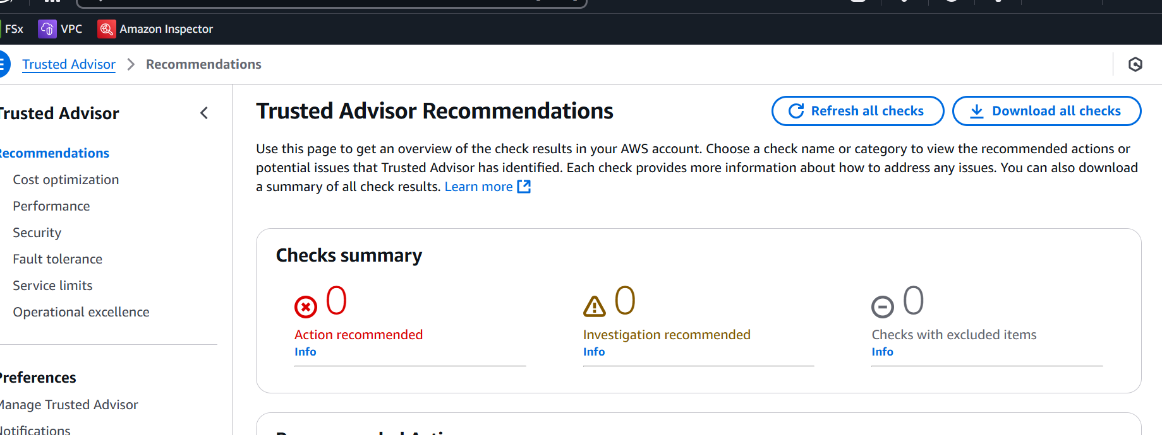
..

Slide 6



